Slide 1


Slide 2
Phonebook Management System in C Language

Slide 3
Presented by:
Name ID
Mosraful Habib 172

Slide 4
Index
Introduction.
Aim of the project.
Advantages & Disadvantages.
Software & Hardware details.
Design.
Modules.
Implementation

Slide 5
Introduction
Phonebook is a very simple mini project in C that can help you understand the basic concepts of functions and file handling. This application will teach you how to add, search, delete,view and exit data to/from the file.
Adding new records, listing them, search for contacts saved, and deleting the phonebook records are the basic functions which make up the main menu of this Phonebook application.

Slide 6
Introduction
Personal information such as name, phone number are asked while adding a record into the Phonebook.
We have used many functions in this mini project. These functions are easy to understand as their name only signifies their respective operations.

Slide 7
Aim of the project
To develop an “Phonebook Management” system using c programming .
This program is very useful now-a-days to store information under contact number.
This program also has options to deletion of the entered contact number.

Slide 8
Advantages & Disadvantages
It becomes easy for the user to store information( i.e name and contact).
It is easy for the user to just search his required contact number by just typing name of the contact.
It is not possible to store detail information(i.e e-mail,address).
This project can not modify the information.

Slide 9
Software & Hardware details.
This Phonebook application is coded and made using the following compilers:
Code::blocks
Size of the code is 2.95 Kb.

Slide 10
Design
The present program consists of the following modules:
Preprocessor commands.
Function.
Variables.
Statements & Expressions.

Slide 11
Module-1
(Header files)
#include<stdio.h>
#include<windows.h>

Slide 12
Module-2
(Declaring functions)
void add_contact();
void search_contact();
void delete_contact();
void view_all_contact();
void main();
exit(0);

Slide 13
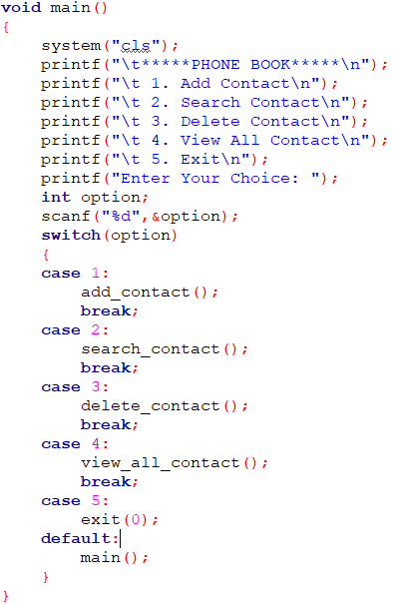
Module-3
(main function)
This function displays the user to select his choice of operations.

Slide 14
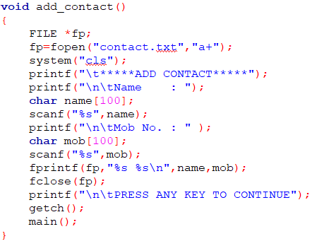
Module-4
(adding contacts)
This module is used for inputting contact details.

Slide 15
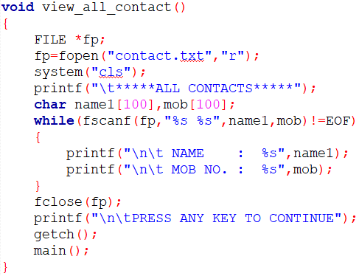
Module-5
(list record)
This part is to show up all the saved contacts list.

Slide 16
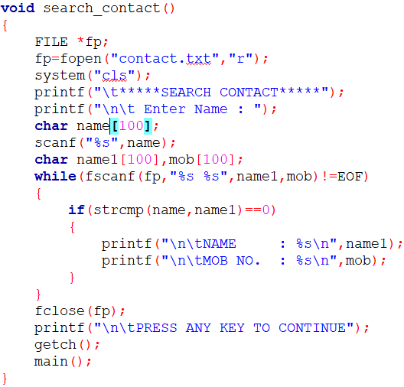
Module-6
(Searching record)
This process lets the user to give in a name to get contact number of the searched contact.

Slide 17
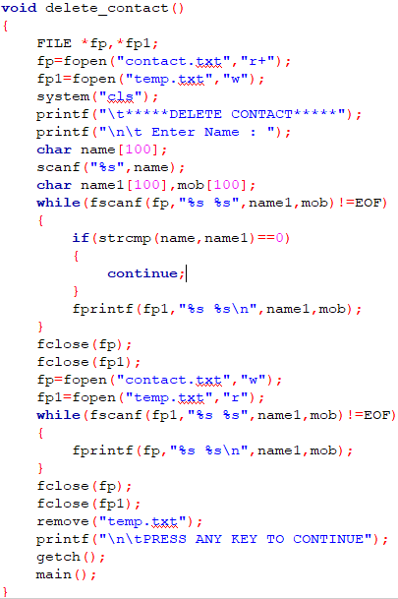
Module-7
(Deleting record)
This option deletes the added contact details of a person.

Slide 18
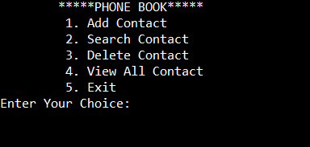
Example for Implementation
The home screen that is displayed by the program is:

Slide 19
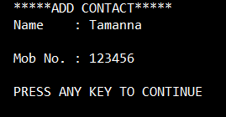
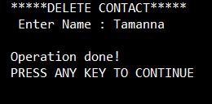
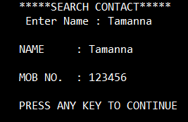
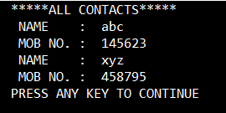
Implementation

Slide 20


